Slide 1
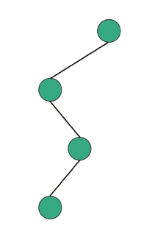
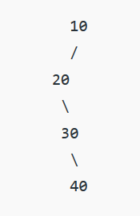
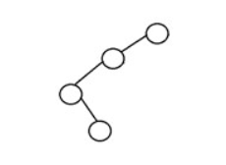
Degenerate/Pathological Binary Tree
Definition & Properties
A Degenerate or Pathological Binary Tree is a type of binary tree in which all the nodes have only either one child or no child.
All the parent nodes will have one and only one child (either left of right).
The tree will behave/perform like a Linked List data structure.
Example

Slide 2
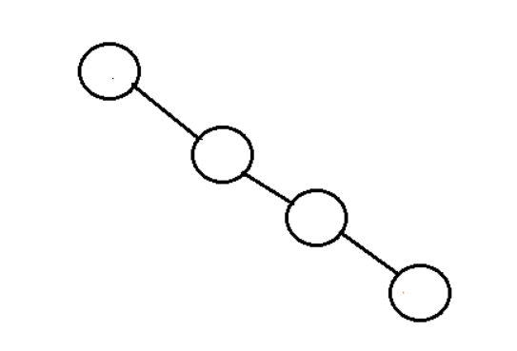
Skewed Binary Tree
Definition & Properties
Skewed Binary Tree is kind of Degenerate or Pathological tree.
If a tree which is dominated by left child node or right child node only, is said to be a Skewed Binary Tree.
Types of Skewed Binary Trees - Two Types of Skewed Binary Trees:
Left Skewed Binary Tree
Right Skewed Binary Tree
Example

Slide 3
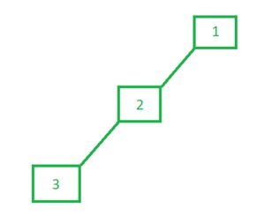
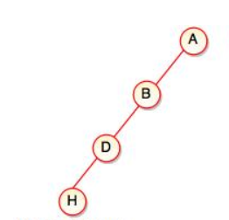
Left Skewed Binary Tree
Definition & Properties
These are those skewed binary trees in which all the nodes are having a left child or no child at all.
In a left skewed tree, all the nodes (except the leaf) node have the left child without corresponding right child.
It is a left side dominated tree.
All the right children remain as null.
Example

Slide 4
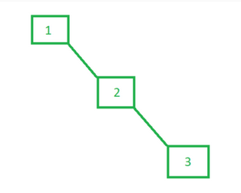
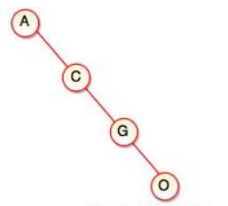
Right Skewed Binary Tree
Definition & Properties
These are those skewed binary trees in which all the nodes are having a right child or no child at all.
In a right skewed tree, all the nodes (except the leaf) node have the right child without corresponding left child.
It is a right side dominated tree.
All the left children remain as null.
Example

Slide 5
Acknowledgements
https://www.upgrad.com/blog/5-types-of-binary-tree/
https://www.geeksforgeeks.org/skewed-binary-tree/
https://www.tutorialride.com/data-structures/types-of-binary-tree.htm
https://www.gatevidyalay.com/tag/left-skewed-binary-tree/
https://towardsdatascience.com/5-types-of-binary-tree-with-cool-illustrations-9b335c430254
https://www.codesdope.com/course/data-structures-red-black-trees/

Slide 6
Why do we need Red-Black Tree? (Because of Skewed Binary Search Trees)
Binary Search Trees (BTSs) can also be skewed!
If we construct a BST for the following list:
10, 8 , 6, 4, 2
We get a Left Skewed Binary Search Tree
If we construct a BST for the following list:
2, 4 , 6, 8, 10
We get a Right Skewed Binary Search Tree
10
2
Red-Black Tree
A self-balancing Binary Search Tree (BST)!
8
4
In terms of a Balanced BST, the operations supported by this Data Structure would take O(log n) amount of time!
But in terms of a Skewed Binary Search Tree (either Left or Right), the height increases as we insert new elements into the tree, thus making it imbalanced. At worst case, operations would take O(n) amount of time!
So, we need a mechanism to make this tree balanced.
6
6
4
8
2
10

Slide 7
Relationships Among the Nodes of a BT or a BST
Root, Leaf, Internal Nodes, Parent, Child, Grandparent, Sibling, Uncle
A is the Root node of this BST.
A
F and E are the Leaf nodes of this BST.
B, C, D are the internal nodes of this BST.
A is the Parent of B and C.
B and C are Child of A.
B is the Parent of F.
F is the Child of B.
C is the Parent of D.
D is the Child of C.
D is the Parent of E.
E is the Child of D.
A is the Grandparent of F and D.
C is the Grandparent of E.
B
C
B and C are Siblings to each other.
F has no Sibling.
D has no Sibling.
E has no Sibling.
F
D
E
C is the Uncle of F.
B is the Uncle of D.
E has no Uncle as D has no Sibling.

Slide 8
Left Rotation on Binary Search Tree (BST)
Suppose, we are performing Left Rotation on the node ‘x’
and the root of x’s right sub-tree is ‘y’.
Currently,
y is the right child of parent x.
Now, the steps of Left Rotation are as follows:
y becomes the new parent as y takes the place of x.
x becomes the root of y’s left sub-tree. At this moment, y is the new parent and x becomes y’s left child.
Before rotation, if there were some elements residing on the left sub-tree of y in the previous tree structure, then after rotation, shift them as the elements of the right sub-tree of x in the new tree structure.
Keep the rest of elements as it is.
5
2
10
So, x is 5
and
y is 10
8
12
6
9
10
5
12
2
8
6
9

Slide 9
Right Rotation on Binary Search Tree (BST)
Suppose, we are performing Right Rotation on the node ‘x’
and the root of x’s left sub-tree is ‘y’.
Currently,
y is the left child of parent x.
Now, the steps of Right Rotation are as follows:
y becomes the new parent as y takes the place of x.
x becomes the root of y’s right sub-tree. At this moment, y is the new parent and x becomes y’s right child.
Before rotation, if there were some elements residing on the right sub-tree of y in the previous tree structure, then after rotation, shift them as the elements of the left sub-tree of x in the new tree structure.
Keep the rest of elements as it is.
10
So, x is 10
and
y is 5
5
12
2
8
6
9
5
2
10
8
12
6
9

Slide 10
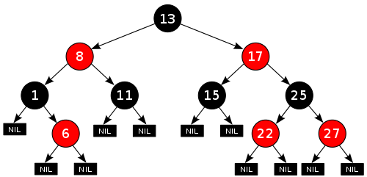
Properties/Characteristics of a Red-Black Tree
A Red-Black Tree is a self-balancing Binary Search Tree (BST).
If a BST follows the following properties, then it will be considered as a Red-Black Tree:
Every node is either Red or Black.
The root must be Black.
Every leaf (NIL/NULL pointers) will be Black. Every internal nodes will have 2 (two) children.
If a node is Red, then both of its children will be Black. No two consecutive Red nodes on any simple path from the root to any leaf.
For each node, all paths from that node to descendant leaves (NIL) contain the same number of Black nodes (this count excludes the node itself!).
Black Height – It is an important term used with Red-Black trees. It is the number of Black nodes on any simple path from a node x (not including it) to a leaf. Black height of any node x is represented by bh(x).
Example of a Red-Black Tree
So, bh (13) = 2
bh(8) = 2
bh(17) = 2
bh(1) = bh(11) = bh(15) = bh(25) = 1
bh(6) = bh(22) = bh(27) = 1
Black Height of all the Leaf Nodes is Zero (0).

Slide 11
Construction of a Red-Black Tree
Steps of constructing Red-Black Tree:
As Red-Black Tree is a self-balancing Binary Search Tree (BST), so elements will be inserted/added into the tree as the same way we constructed Binary Search Tree (BST) from a given list of elements!
We do the following steps recursively for every element in the given list:
Pick an element, name it as ‘z’, color it Red and insert it as a node into the tree.
If violation arises, Recolor and Rotate nodes until the violation is fixed/solved.
Violations may occur in terms of constructing a Red-Black Tree when:
The Root is colored as Red As the Root of a Red-Black Tree must be Black.
A new element is inserted as a child of an existing Red parent and then it is colored as Red. As two consecutive Red nodes are not allowed.

Slide 12
Construction of a Red-Black Tree
Visual Representation of Violations in a Red-Black Tree
(We will be referring any new element as ‘z’ at the time of insertion)
The Root is colored as Red, as the Root of a Red-Black Tree must be Black.
A new element is inserted as a child of an existing Red parent and then it is colored as Red, as two consecutive Red nodes are not allowed.
R
z
R
R
x
y
R
R
z
z

Slide 13
Construction of a Red-Black Tree
4-scenarios of fixing the Violations in a Red-Black Tree
(We will be referring any new element as ‘z’ at the time of insertion)
If z is inserted as the Root and is colored as Red, just recolor the root as Black.
If z is inserted as the child of an existing Red parent node and is colored as Red, then the color of z’s uncle is examined!
a) If the color of z’s uncle is Red, just recolor z’s parent, z’s grandparent and z’s uncle.
R
B
z
z
B
R
w
w
R
R
B
B
x
y
x
y
R
R
R
R
R
R
R
R
z
z
z
z
z
z
z
z

Slide 14
Construction of a Red-Black Tree
4-scenarios of fixing the Violations in a Red-Black Tree
(We will be referring any new element as ‘z’ at the time of insertion)
b) If the color of z’s uncle is Black, then
i) If z, z’s Parent and z’s Grandparent form a Triangular shape among themselves, then just rotate z’s parent in the opposite direction of z.
B
B
w
z is the left child of it’s parent y
y is the right child of its parent w
Right Rotation on parent y!
w
B
R
B
R
x
y
x
z
R
R
B
y
B
w
z
w
z is the right child of it’s parent x
x is the left child of its parent w
Left Rotation on parent x!
R
B
R
B
z
y
x
y
R
R
x
z

Slide 15
Construction of a Red-Black Tree
4-scenarios of fixing the Violations in a Red-Black Tree
(We will be referring any new element as ‘z’ at the time of insertion)
b) If the color of z’s uncle is Black, then
ii) If z, z’s Parent and z’s Grandparent form a Straight Line shape among themselves, then rotate z’s Grandparent in the opposite direction of z and recolor z’s original Parent and Grandparent after the rotation.
B
B
y
w
z is the right child of it’s parent y
y is the right child of its parent w
Left Rotation on Grandparent w!
And Recolor y and w.
R
R
B
R
w
z
x
y
R
B
z
B
x
B
w
x
z is the left child of it’s parent x
x is the left child of its parent w
Right Rotation on Grandparent w!
And Recolor x and w.
R
B
R
R
x
y
z
w
R
B
z
y

Slide 16
Construction of a Red-Black Tree
Example: Construct a Red-Black Tree for the following list of elements
10, 18, 7, 15, 16, 30 , 14, 8, 2
We will refer any new element as ‘z’ at the time of insertion.
‘z’ will be used to refer the Child Node where violation still remains!
Elements will be inserted by following the properties of BST!
Check if there is any Violation immediately after:
Inserting a new element to the tree and coloring it red
Solving a violation as it may cause new violation
Root must be Black!
So, violation occurs!
So, Recolor the Root.
R
B
Root must be Black!
So, violation occurs!
So, Recolor the Root.
10
z
B
10
R
B
No Violation
R
B
15 is Red.
15’s Parent 16 is also Red.
So, violation still exists!
15’s Uncle Leaf (NIL) is Black.
15, 16, 18 form a Straight Line!
So, Right Rotate 18 and Recolor 16 and 18.
z
7
18
z
B
B
7
18
15
R
B
R
z
NIL
B
16
NIL
15 is Red.
15’s Parent 18 is also Red.
So, violation occurs!
15’s Uncle 7 is Red.
So, Recolor 18, 10 and 7.
R
16
16 is Red.
16’s Parent 15 is also Red.
So, violation occurs!
16’s Uncle Leaf (NIL) is Black.
16, 15, 18 form a Triangular shape!
So, Left Rotate 15.
R
z
15
z

Slide 17
Construction of a Red-Black Tree
Example: Construct a Red-Black Tree for the following list of elements
10, 18, 7, 15, 16, 30, 14, 8, 2
B
10
bh (10) = 2
bh (7) = 1
bh (16) = 2
bh (2) = bh(8) = bh(15) = bh(18) = 1
bh(14) = bh(30) = 1
B
No Violation
16
B
R
7
R
R
R
B
R
B
2
8
15
18
R
R
z
z
z
14
30
z
NIL
NIL
NIL
NIL
NIL
NIL
30 is Red.
30’s Parent 18 is also Red.
So, violation occurs!
30’s Uncle 15 is Red.
So, Recolor 18, 16 and 15.
NIL
NIL
NIL
NIL

